Slide 1
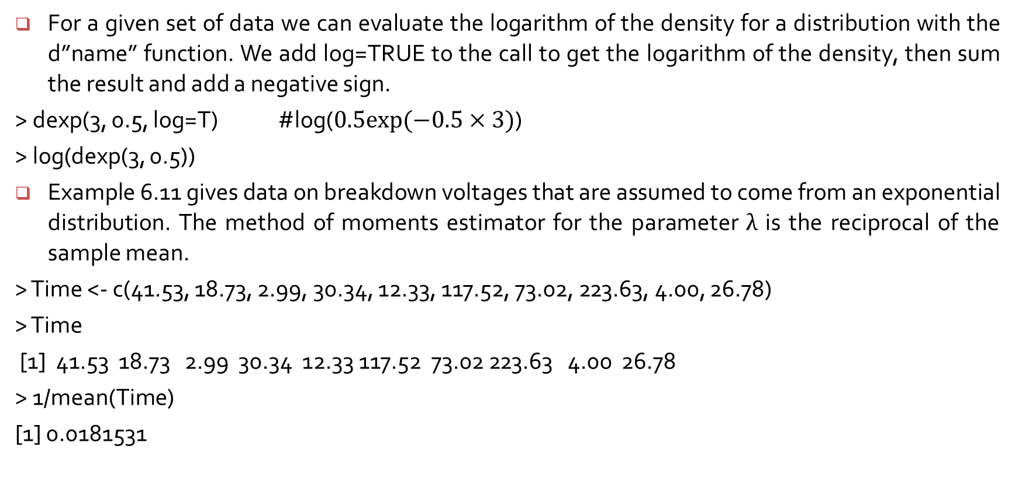
Using $R$to get mle’s
For a given set of data we can evaluate the logarithm of the density for a distribution with the d”name” function. We add log=TRUE to the call to get the logarithm of the density, then sum the result and add a negative sign.
> dexp(3, 0.5, log=T) #log($0.5exp⁡(−0.5×3)$)
> log(dexp(3, 0.5))
Example 6.11 gives data on breakdown voltages that are assumed to come from an exponential distribution. The method of moments estimator for the parameter $λ$ is the reciprocal of the sample mean.
> Time <- c(41.53, 18.73, 2.99, 30.34, 12.33, 117.52, 73.02, 223.63, 4.00, 26.78)
> Time
[1] 41.53 18.73 2.99 30.34 12.33 117.52 73.02 223.63 4.00 26.78
> 1/mean(Time)
[1] 0.0181531

Slide 2
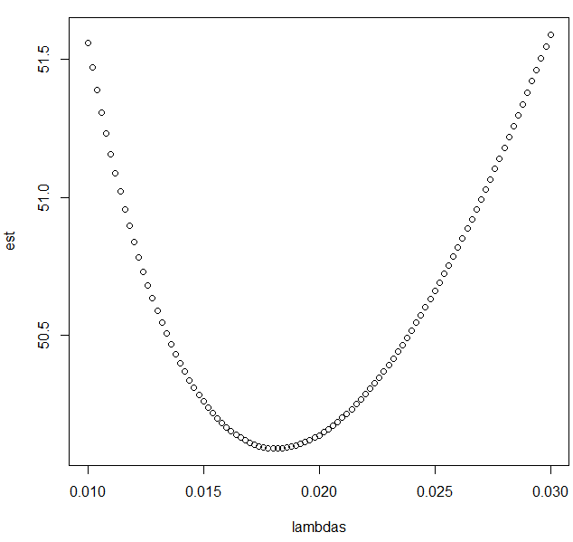
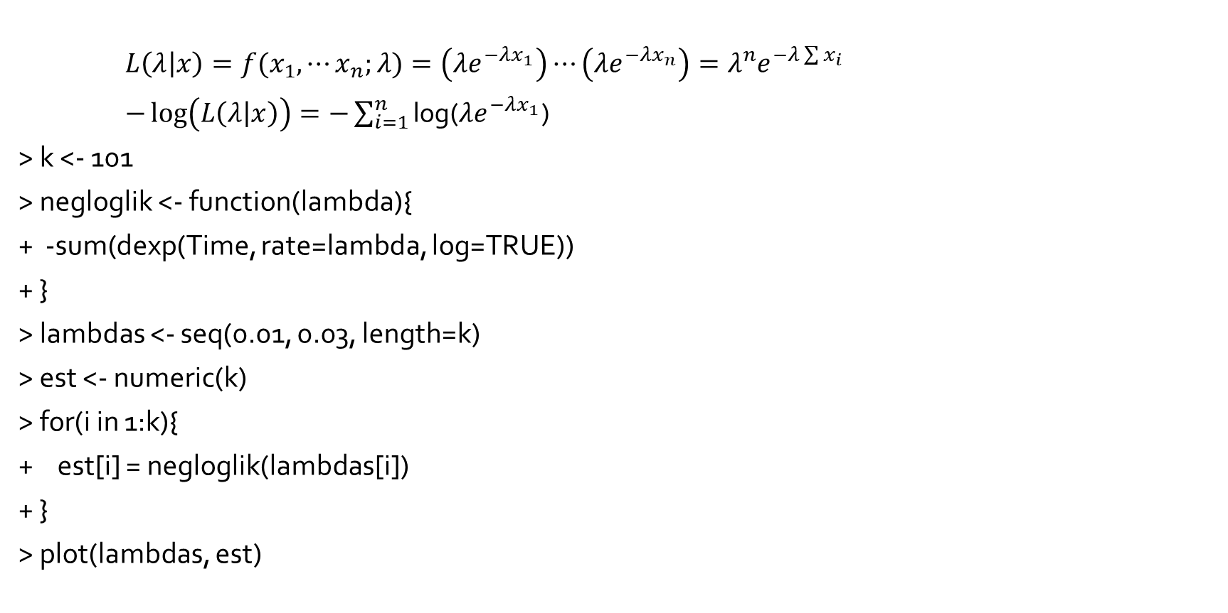
Using $R$to get mle’s
${L\left(λ | x\right)=f(x}_{1}, ⋯x_{n};λ)=\left(λe^{−λx_{1}}\right)⋯\left(λe^{−λx_{n}}\right)=λ^{n}e^{−λ\sum{x_{i}}}$
$−\log\left(L\left(λ | x\right)\right)=−\sum_{i=1}^{n}{\text{log}}$($λe^{−λx_{1}}$)
> k <- 101
> negloglik <- function(lambda){
+ -sum(dexp(Time, rate=lambda, log=TRUE))
+ }
> lambdas <- seq(0.01, 0.03, length=k)
> est <- numeric(k)
> for(i in 1:k){
+ est[i] = negloglik(lambdas[i])
+ }
> plot(lambdas, est)

Slide 3
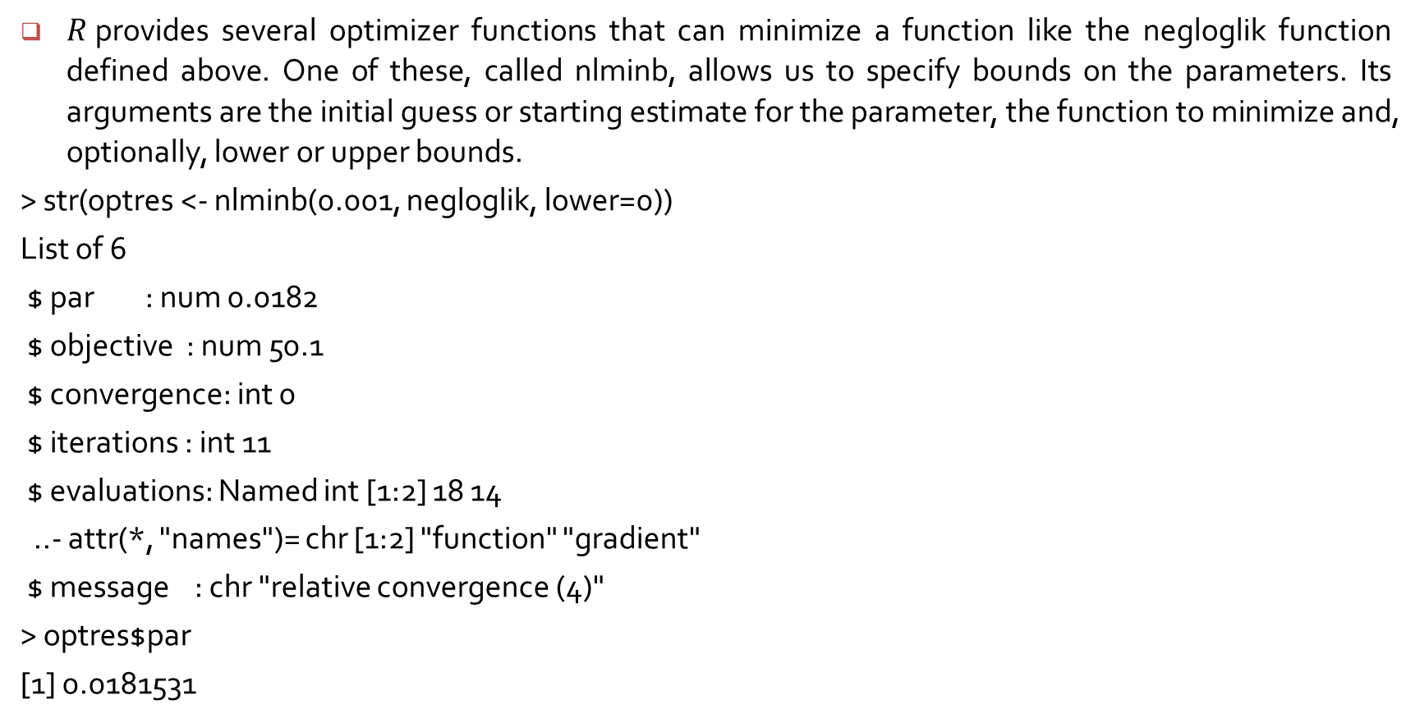
Creating the estimates
$R$provides several optimizer functions that can minimize a function like the negloglik function defined above. One of these, called nlminb, allows us to specify bounds on the parameters. Its arguments are the initial guess or starting estimate for the parameter, the function to minimize and, optionally, lower or upper bounds.
> str(optres <- nlminb(0.001, negloglik, lower=0))
List of 6
$ par : num 0.0182
$ objective : num 50.1
$ convergence: int 0
$ iterations : int 11
$ evaluations: Named int [1:2] 18 14
..- attr(*, "names")= chr [1:2] "function" "gradient"
$ message : chr "relative convergence (4)"
> optres$par
[1] 0.0181531

Slide 4
Computation of the value of x that yields the minimum of a function.
> cubic <- function(x) {
+ x^2 + 2*x + 1
+ }
> nlminb(0, cubic)
$par
[1] -1
$objective
[1] 0

Slide 5
Mle for the normal distribution :
> x <- rnorm(30, 3, 2)
> negloglik <- function(par) -sum(dnorm(x, mean=par[1], sd=par[2], log=TRUE))
> str(optres <- nlminb(c(1,1), negloglik, lower=c(-100, 0))
Mle for the negative binomial distribution :
> x <- rnbinom(1000, mu = 10, size = 10)
> hdev <- function(par)
+ -sum(dnbinom(x, mu = par[1], size = par[2], log = TRUE))
> nlminb(c(9, 12), hdev)

